Slide 1
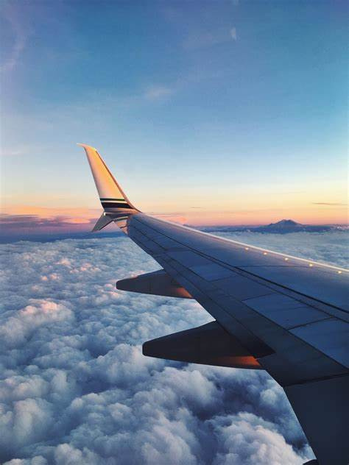

Airline Passenger Satisfaction
OCTOBER 18, 2024

Slide 2








Team members
Mariam Abd elhamied
Shorouk Ashraf
Omar Hazem
Mostafa El Demery

Slide 3


Agenda Overview
01
Introduction
05
Results
02
Data Flow
06
Recommendation
03
Dataset Overview
07
Conclusion
04
Analysis Steps

Slide 4

Introduction
With the rapid development in the aviation industry and increasing competition among airlines, fulfilling passenger needs and enhancing their experience have become key factors that influence customer satisfaction and loyalty.
This project aims to analyze the main factors affecting passenger satisfaction and explore opportunities to improve the services provided to them.
By analyzing data related to airline services and customer feedback, we will provide practical recommendations to enhance the travel experience and boost passenger satisfaction.

Slide 5





DATA ANALYSIS FLOW
5-Step Analysis Process
Analyzing
Data
Check data
1
2
3
4
5
Collect Data
Explore data
Visualize and Reporting

Slide 6
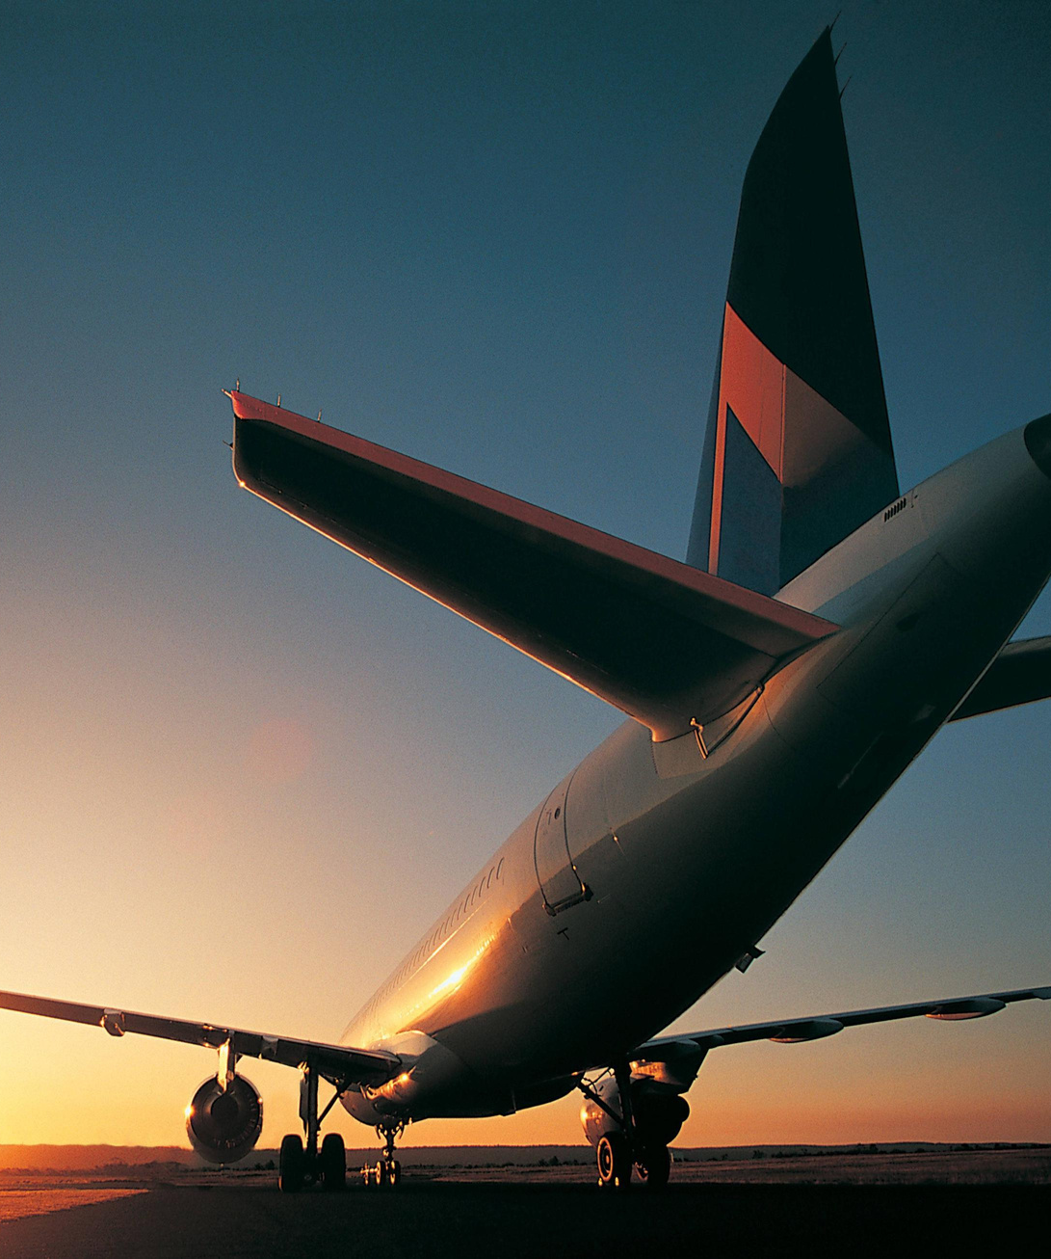
Dataset Overview
Goal: Analyze key factors affecting passenger satisfaction in the competitive aviation industry.
Approach: Examine airline services and customer feedback to identify improvement opportunities.
Usefulness: Helps airlines identify areas for improvement, enhance customer experiences, and make data-driven decisions to optimize services.

Slide 7
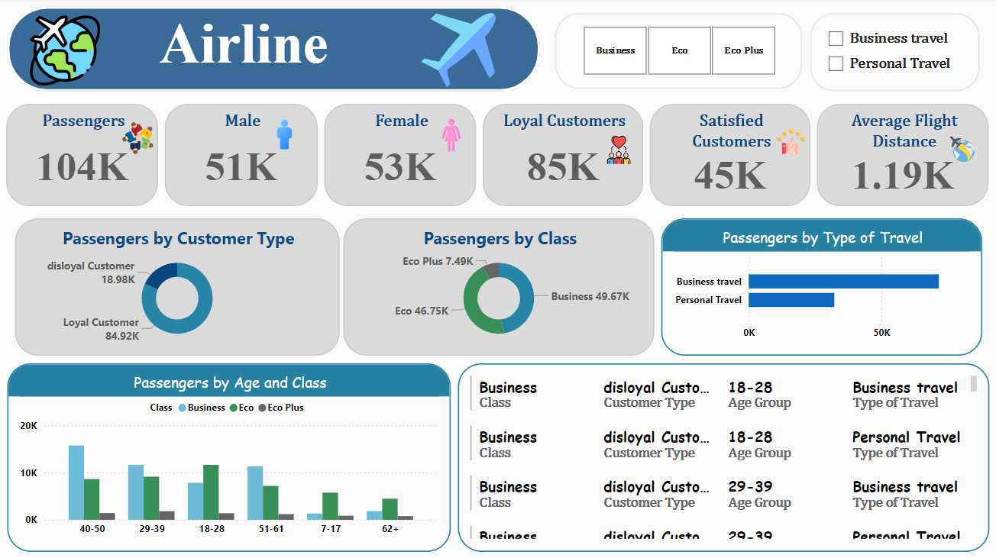
Airline Path
Passenger Demographics:
- The airline served 104K passengers, with 51K males and 53K females.
- It had 85K loyal customers and 45K satisfied passengers.
Travel Type and Class:
- Passengers were segmented by travel type (Business and Personal) and
class (Business, Eco, and Eco Plus).
- About 50K traveled for business, with 46.75K in the Economy class.
Customer Segmentation:
- The report details passenger distribution by age, customer type (loyal vs
disloyal), and class.
- It also showing 84.92K loyal passengers and 18.98K disloyal ones.

Slide 8
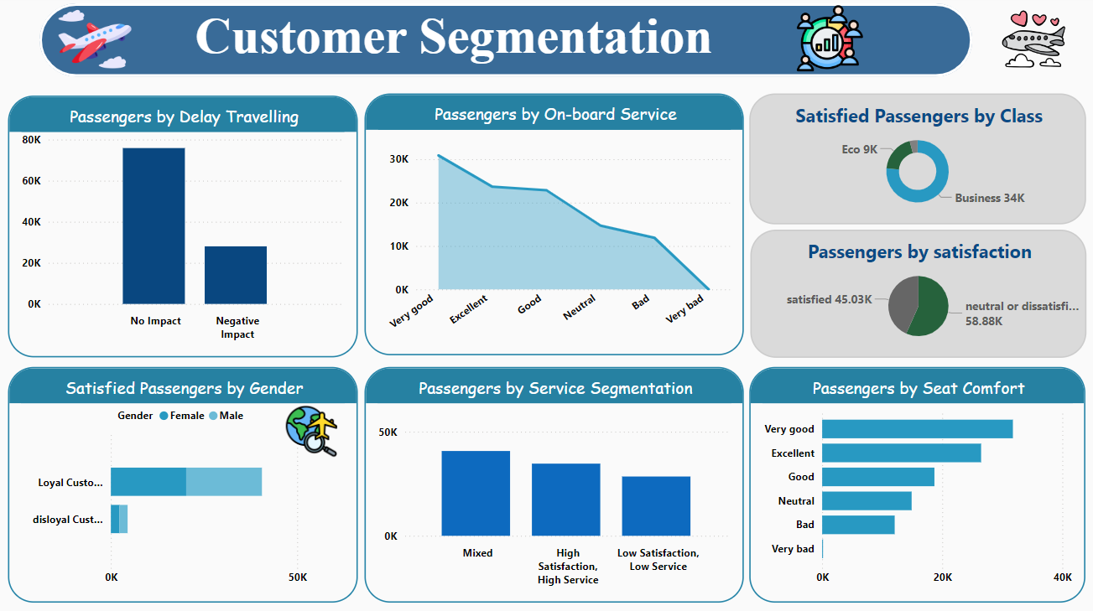
Customer Segmentation
Purpose: Understand different passenger groups based on behaviors and preferences.
Impact of Delays:
- Approximately 80K passengers reported no impact from delays,
while a smaller group experienced negative effects.
Passenger Satisfaction:
- Out of all passengers, 45.03K were satisfied, predominantly from
the business class, whereas 58.88K were neutral or dissatisfied.
Service Segmentation:
- Passengers rated onboard services with around 50K reporting
high satisfaction due to high service quality.

Slide 9
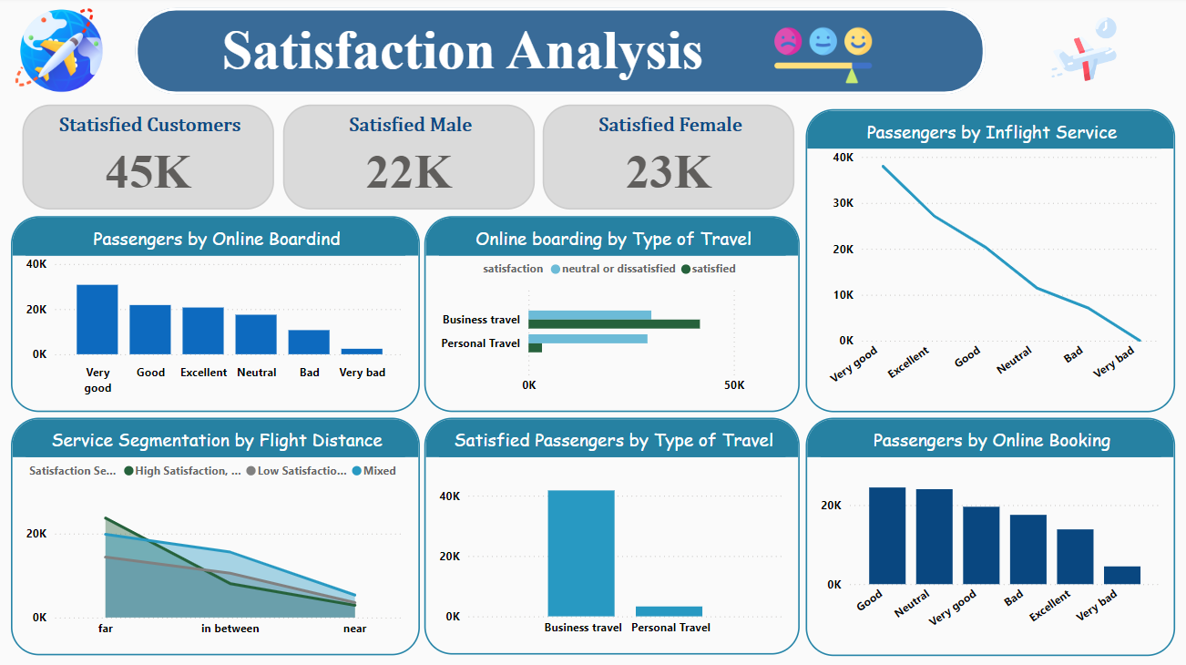
Satisfaction Analysis
Satisfied customers:
- There are 45K satisfied customers, with 22K males and
23K females, indicating a relatively balanced satisfaction.
High satisfaction areas:
- Online bookings and business travel have the highest
satisfaction levels.
Satisfaction drop:
- Customer satisfaction drops significantly with shorter
flight distances and weaker in-flight services.

Slide 10
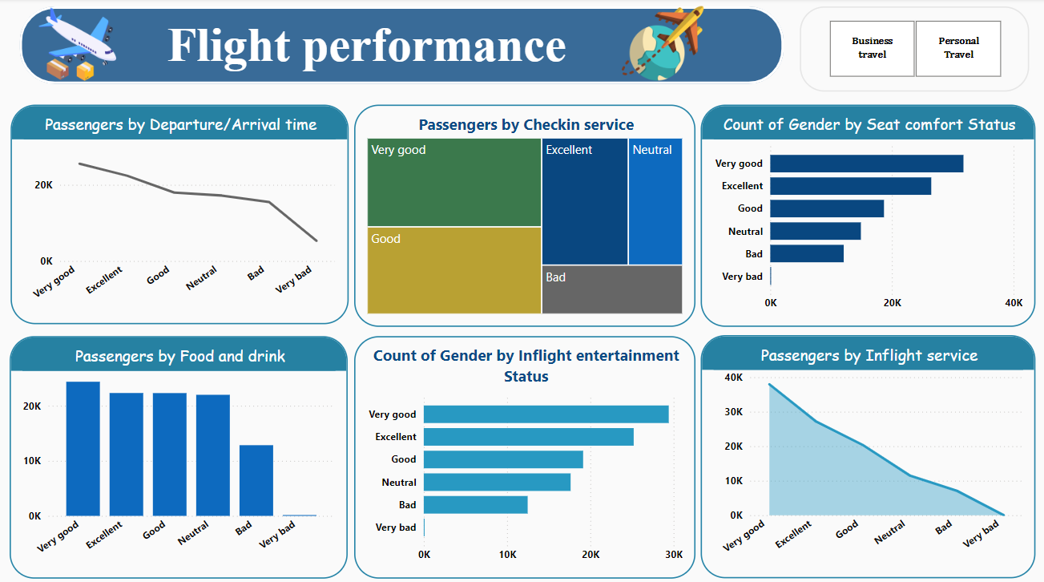
Flight Performance
Purpose: To enhance customer experience by using feedback data to refine flight services.
Passenger Satisfaction:
- The dashboard shows passenger satisfaction with flight services like
check-in, food, and inflight service.
Passenger Ratings:
- Ratings range from "very good" to "very bad," with higher satisfaction
noted for food and lower for seat comfort.
Gender-Based Insights:
- Some charts provide detailed analysis of passenger satisfaction based
on gender, particularly for entertainment and seat comfort.

Slide 11
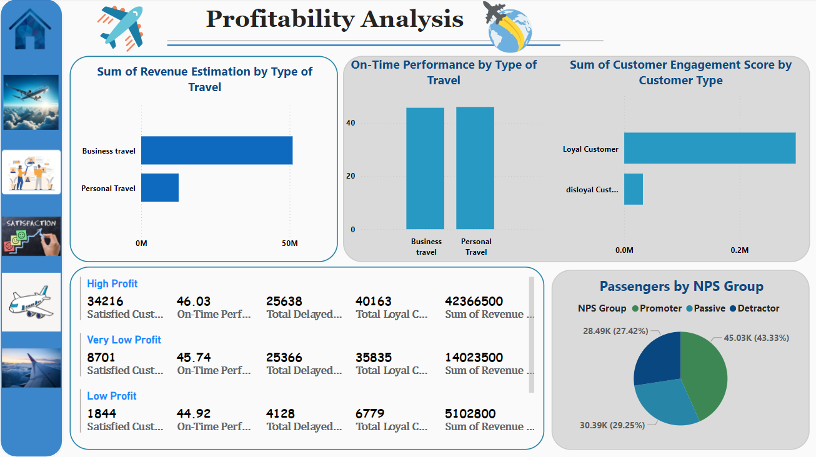
Profitability Analysis
Revenue and Travel Type:
- Business travel generates significantly higher revenue compared to
personal travel.
Customer Loyalty and Engagement:
- Loyal customers have much higher engagement scores, which
indicating their critical role in maintaining profitability.
Profitability Segmentation:
- High-profit segments have more satisfied and loyal customers, better
on-time performance, and significantly higher revenue compared to
low-profit segments.

Slide 12
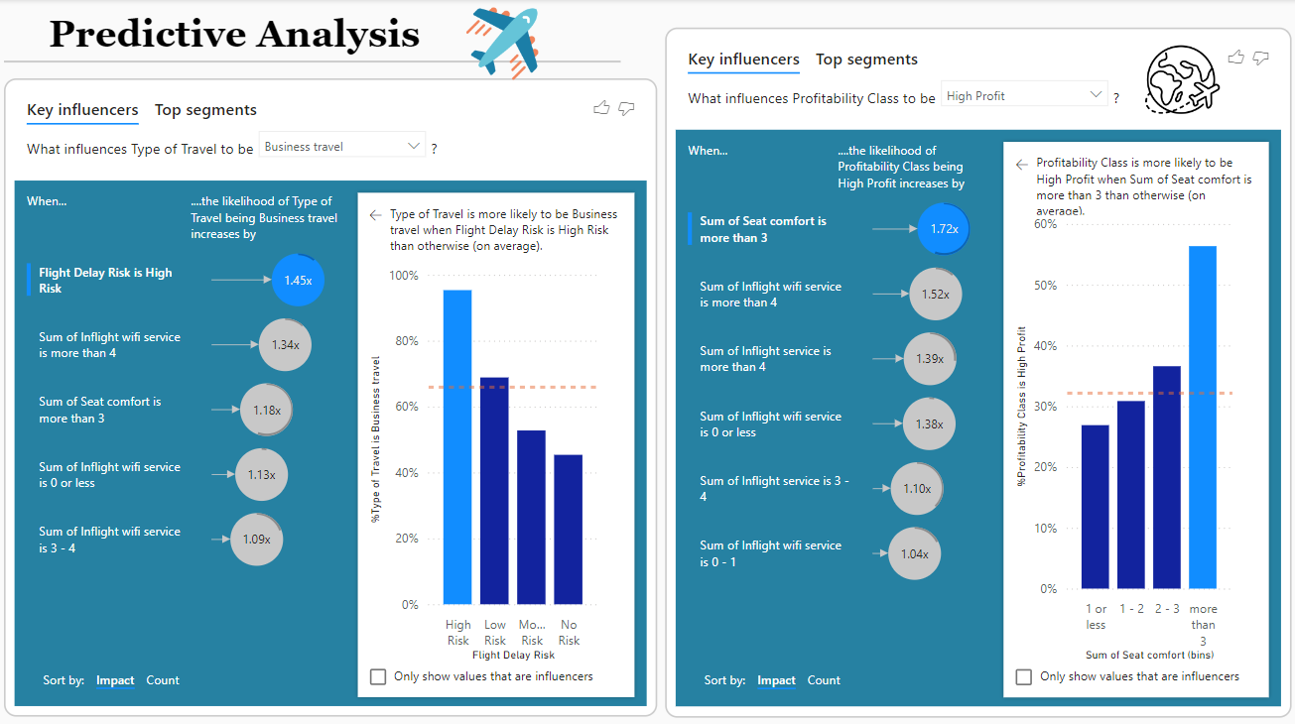
Predictive Analysis
Key Influencers of Business Travel:
- Factors like high flight delay risk and inflight Wi-Fi service
significantly increase the likelihood of travel being business-related.
Seat Comfort and Profitability:
- Higher seat comfort, combined with quality inflight services,
increases the chances of flights achieving high profitability.
Impact of Flight Delays and Service Quality:
- Business travel is more likely under high flight delay risks, and .
profitability rises with better inflight service and seat comfort.

Slide 13

Results
Customer segmentation:
The airline has a significant number of loyal customers, accounting for 85K out of 104K total passengers.
Business class passengers have higher satisfaction levels than economy class passengers.
Female passengers are more satisfied than male passengers.
Flight performance:
Reducing flight delays positively impact customer satisfaction and retention.
Check-in service is generally rated positively, with most passengers rating it as "good" or "very good.“.
Seat comfort and inflight entertainment are areas where the airline can improve to enhance the overall flight experience.

Slide 14

Results
Predictive analysis:
Revenue estimation is higher for business class passengers compared to economy class passengers.
On-time performance is a key factor influencing customer satisfaction and loyalty.
NPS analysis reveals that the airline has a mix of promoters, passives, and detractors.
Profitability analysis:
Key influencers for profitability class include flight distance, fare class, and customer loyalty.
Top segments for profitability class include long-haul business class passengers and high-spending loyal customers.
Top segments for type of travel include flight distance, fare class, and customer demographics and international business and domestic leisure travelers.

Slide 15



Recommendations
Enhance Passengers Experience
Reduce Flight Delays
Utilize Predictive Analytics
Prioritize improving the overall customer experience, especially for disloyal customers.
Focus on passenger comfort by improving seat quality, offering a variety of entertainment options.
Invest in measures to improve on-time performance and minimize the impact of delays.
Employ predictive modeling techniques to anticipate customer needs and preferences, enabling proactive service adjustments and identify areas for improvement.

Slide 16
Conclusion
In conclusion, Airline Passenger Satisfaction analysis reveals the key to transforming flights into memorable experiences. By focusing on demographics, service quality, and minimizing delays, airlines can personalize services and boost satisfaction.
Predictive analytics enables proactive strategies, allowing airlines to anticipate passenger needs and build loyalty, ensuring long-term success in a competitive market.

Slide 17
Thank you

